Slide 1
Video 14 - Writing a research proposal
Steve Simon

Slide 2
Research grant process
Read the solicitation and guidelines
Build a research team
Submit a letter of intent, if asked
Prepare a draft proposal
Get internal reviewers and administrative approval
Submit proposal and wait
Notes:
Every research grant is different, but here are the general steps that most grants follow.

Slide 3
Read the solicitation and guidelines
Solicitation
BAA, RFA, RFP, others
List of what you can/cannot propose
Allowable expenses
Deadline
Guidelines
Proposal length
Proposal structure
Notes:
I’m going to describe the granting process from the perspective of the National Institutes of Health. There are other governmental agencies that distribute grant money for research, such as the Department of Defense and the National Science Foundation. Grants are also available from private organizations, such as the Bill and Melinda Gates Foundation and the American Heart Association.
Almost all grant opportunities are described in some type of solicitation. It may be called a Broad Agency Announcement (BAA), Request for Applications (RFA), or Request for Proposals (RFP). These are the NIH terms, but other granting agencies will probably use different acronyms.
The solicitation will provide a list of what you can propose. It is sometimes very specific, but at times it is open ended with examples but allows for other options.
The important thing, however, is that you must, must, must pay attention to what you cannot do. If you can’t run a clinical trial, don’t propose a clinical trial.
Also look at the list of allowable expenses. Can you use the money for travel? Can you use it for the purchase of computer equipment?
Also note the deadline. You should start work on a grant two or three months prior to the deadline.

Slide 4
Build a research team
“No man is an island” John Donne
Find researchers with the skills you lack
Brag about them
Brag about yourself
Notes:
I want to start with the famous quote by John Donne: no man is an island. You could also say that no researcher is an island. Many centuries ago, there were great scientists who could do it all by themselves: Benjamin Franklin, Isaac Newton, Marie Curie. Times have changed and science has become so diverse that no one person can do it all.
So your job as the grant writer is to build a team, with each person providing specialized skills that you lack.
Your job in the grant is to brag about your team. Don’t be shy here. Your team is the best and is the most capable of conducting this research.
Don’t forget to brag about yourself. Even if you are relatively new to research, you have some training in classes like this one and you also have job experiences related to the work you are proposing. Let the reviewers know about this. Don’t make up stuff, of course, but do put in anything you can think about yourself that makes you look special.

Slide 5
Build a research team, patient accrual model (1/2)
Accrual = how fast you can recruit patients
Criticized on software development angle
Failure to mention my expertise
Failure to recruit other experts
Notes:
A few years ago, I proposed a research grant that proposed, among other things, to develop some software to help researchers plan their accrual rates. Accrual is the speed at which you expect to recruit patients into your clinical trial. Accrual is the flip side of sample size calculation. It make no sense to propose a sample size of 500 patients if it would take two decades to find that many volunteers.
The grant was not funded, and when I got feedback, one major deficiency was that no one on the research team was familiar with software development. So this provided me with two lessons.
First, I did not brag enough about how much I know about software development. Now I am not an expert in software development, but I am not a total novice either. But I didn’t describe my skills in this area. So remember to always brag about yourself.
Second, I knew some experts in software development through my work with the Kansas City R Users Group. In particular, I knew someone who was an expert in testing user interfaces. So I talked to him and said, described the grant, and asked for his help when I prepared a resubmission. I did not end up resubmitting because of competing time commitments, but the lesson still holds.

Slide 6
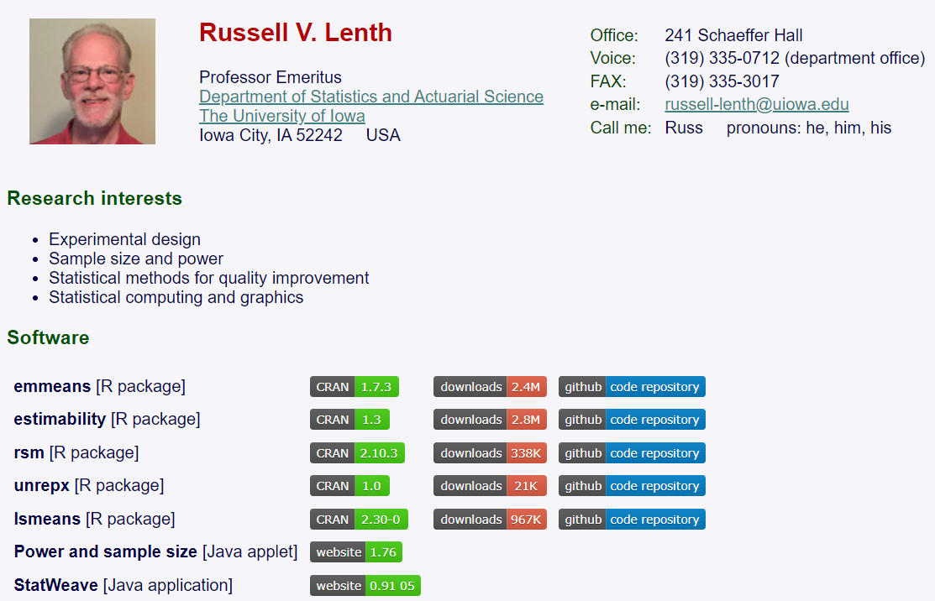
Build a research team, patient accrual model (2/2)
Notes:
Actually, I did get praise for including a researcher, Russ Lenth, who was the pre-eminent expert on sample size calculation. As I mentioned, accrual is the neglected partner of sample size calculation, and Dr. Lenth provided a level of technical expertise that the reviewers noted and commented on favorably.
Let me share a second story. This one was about another unsuccessful grant. Again, one thing I did well was to develop a strong research team.
There was a call for developing training modules for biomedical researchers. Right up my alley, I thought to myself. Now I need to be careful because there are a lot of people who are far better at developing courses than I am. But I do provide some unique skills that set me apart. In particular, I am very good at finding interesting datasets that can be used as exercises or teaching examples.
There has been a lot of interest recently in data sharing. There is an increasing push for researchers to include their datasets along with any peer reviewed publication. There are privacy concerns, of course, with many datasets. Even so, there are ways to protect patient privacy and still share the data.
So I wanted to propose a series of training videos on the issues associated with data sharing–issues like documentation, which are often overlooked. Now part of my job was to assemble a research team.
One of the first steps was to involve an expert in curriculum development.
Mike Abel

Slide 7

Build a research team, peer-reviewed datasets (1/4)
Notes:
Let me share a second story. This one was about another unsuccessful grant. Again, one thing I did well was to develop a strong research team.
There was a call for developing training modules for biomedical researchers. Right up my alley, I thought to myself. Now I need to be careful because there are a lot of people who are far better at developing courses than I am. But I do provide some unique skills that set me apart. In particular, I am very good at finding interesting datasets that can be used as exercises or teaching examples.
There has been a lot of interest recently in data sharing. There is an increasing push for researchers to include their datasets along with any peer reviewed publication. There are privacy concerns, of course, with many datasets. Even so, there are ways to protect patient privacy and still share the data.
So I wanted to propose a series of training videos on the issues associated with data sharing–issues like documentation, which are often overlooked. Now part of my job was to assemble a research team.
One of the first steps was to involve an expert in curriculum development.

Slide 8

Build a research team, peer-reviewed datasets (2/4)
Notes:
The second step was to identify someone who could provide an evaluation of the curriculum.

Slide 9
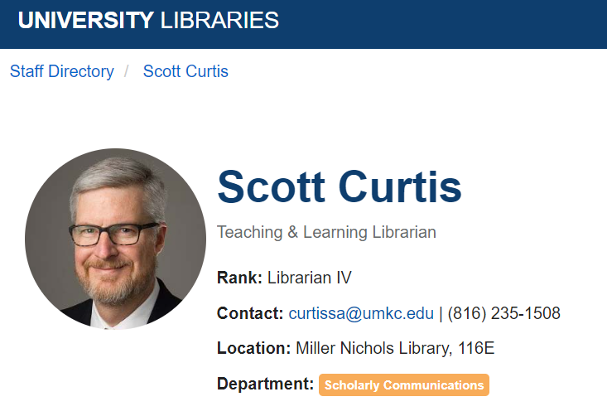
Build a research team, peer-reviewed datasets (3/4)
Notes:
THe third step was to recruit a librarian. I actually ended up with two librarians.

Slide 10
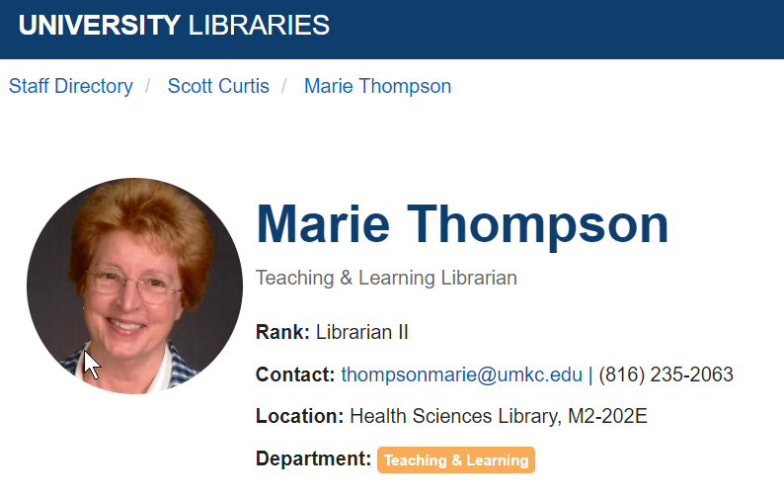
Build a research team, peer-reviewed datasets (4/4)
Notes:
Here is the second librarian.

Slide 11
Submit a letter of intent, if asked
Very brief description

Slide 12
Elements of a research proposal
Literature review
Methods section
Preliminary data
Proof of your capabilities
Not always available
Strengths of the research team
Notes:
Broadly speaking, you already know the bulk of what is needed for a research grant. You summarize what is already known and the propose methods to add to what we know.
The third element in most grants is discussion of preliminary data. Preliminary data is data that you yourself have collected. It isn’t data that addresses your proposed research. Otherwise you wouldn’t need money–the work is already done. Preliminary data is data that shows that you have been an active participant in this research area. It demonstrates that you have proven yourself capable of doing research along the same lines of what you propose in your methods section.
You would summarize your preliminary data the same way that you summarize other people’s work with two exceptions. First, you spend a lot more time and discuss your own work in a lot more detail. Second, you include preliminary data, even if it has not been published yet.
Some grants require you to have preliminary data. If you don’t have it, you will get a tepid review. Other grants do not require preliminary data. Even when the grant solicitations or guidelines states that preliminary data is not needed, it does help to present it when you have it.
You also need to convince the reviewers

Slide 13
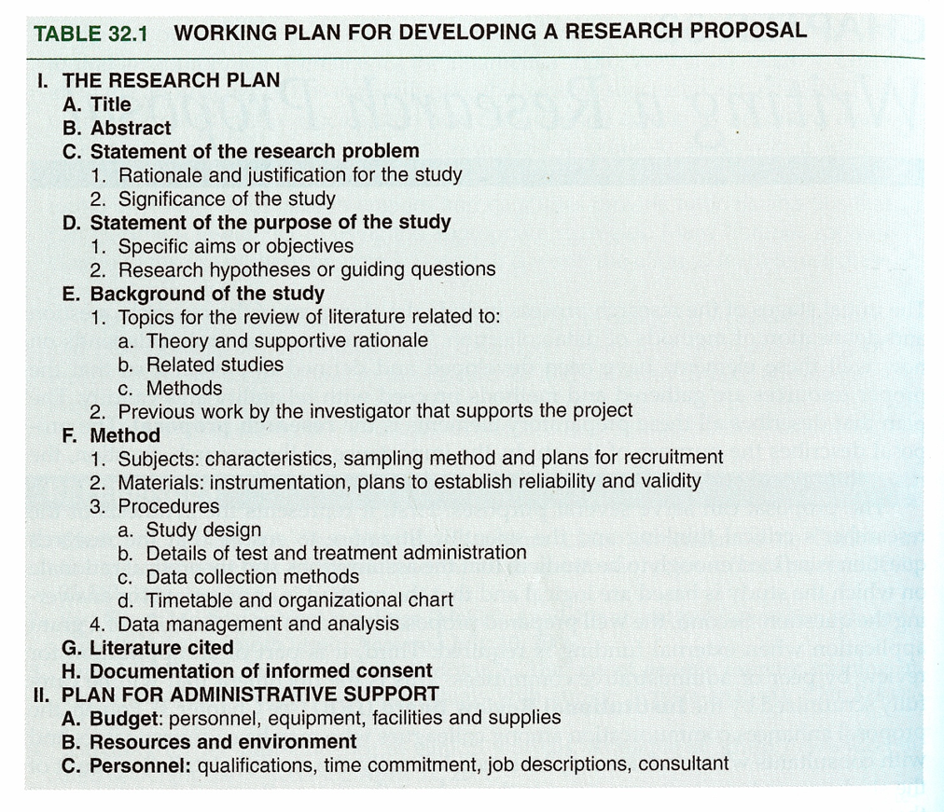
Research Proposal
Notes:
Portney & Watkins, 2009

Slide 14
Research Proposal
Components
Title
Abstract
Body of proposal
Statement of the problem
Purpose, Hypotheses, and Specific Aims
Background

Slide 15
Research Proposal
Components
Methods
Subjects
Materials
Procedures
Data Analysis
References
Informed consent plans

Slide 16
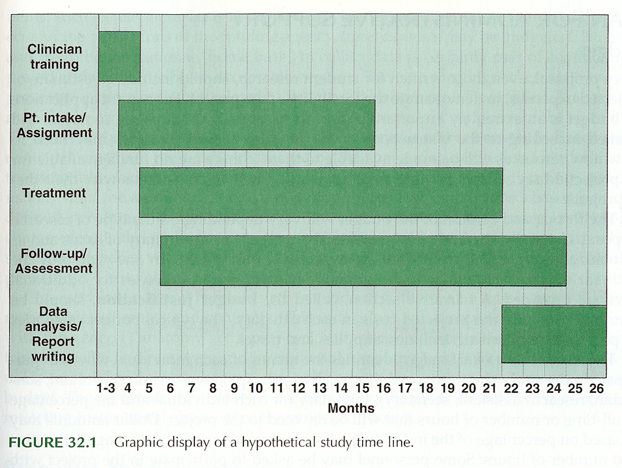
Research Proposal
Notes:
Portney & Watkins, 2009

Slide 17
Research Proposal
Examples of proposal material
Timeline
Protocol Schedule
Measures

Slide 18
Research Proposal
Administrative Support
Budget - #s and justification
Resources and environment
Personnel
Proposal presentation style
Format – rules and suggestions

Slide 19
Research Proposal
Examples – Other funding mechanisms
National Science Foundation
CDC
Other government agencies
Foundations
Internal funding mechanisms

Slide 20
Writing Style
Proposal – “forward-looking document”
Tense
Statement of problem (present tense)
Background (past tense)
Method (future tense)
Format – varies
Tone
Positive, persuasive, scholarly

Slide 21
Writing Style
Report – “exercise in organization and clarity of expression”
Specifics
People first
Active vs passive voice
Simplicity of language

Slide 22
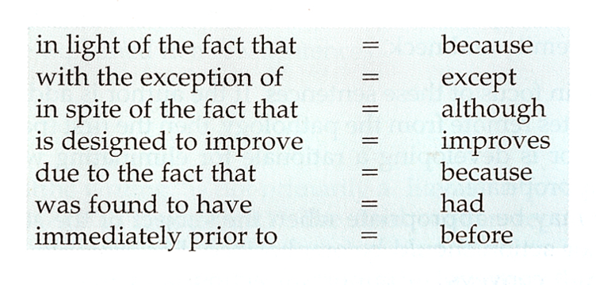
Writing Style

Slide 23
Reporting Clinical Research
Journal article
Selecting journal
Preparing the submission
Structure and content (P & W, Table 33.1)

Slide 24
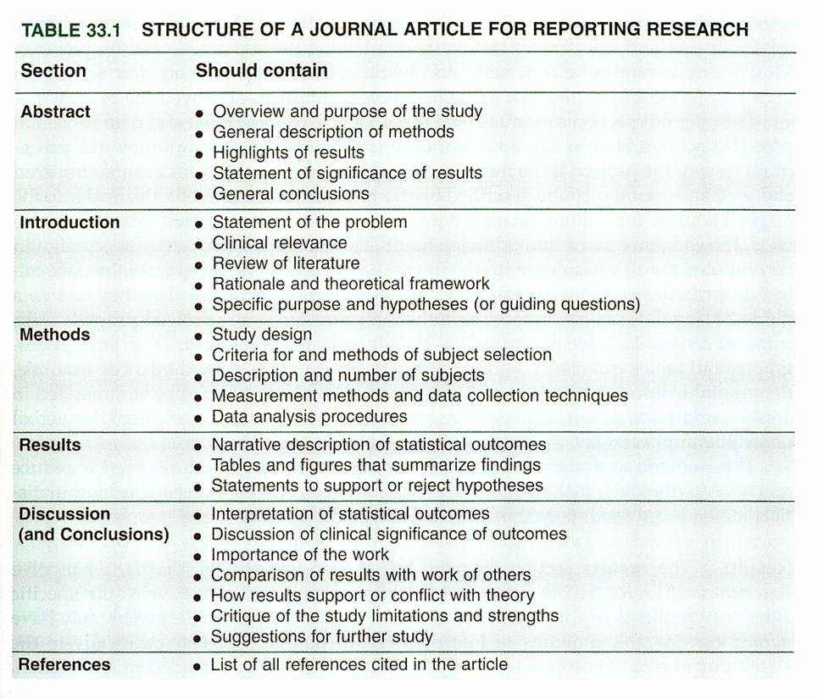
Reporting Clinical Research
Notes:
.footnote[Portney & Watkins, 2009]

Slide 25
Reporting Clinical Research
Journal article
Preparing the submission
Structure and content (Table 33.1)
Tables and graphs
Publishing thesis and/or dissertation

Slide 26
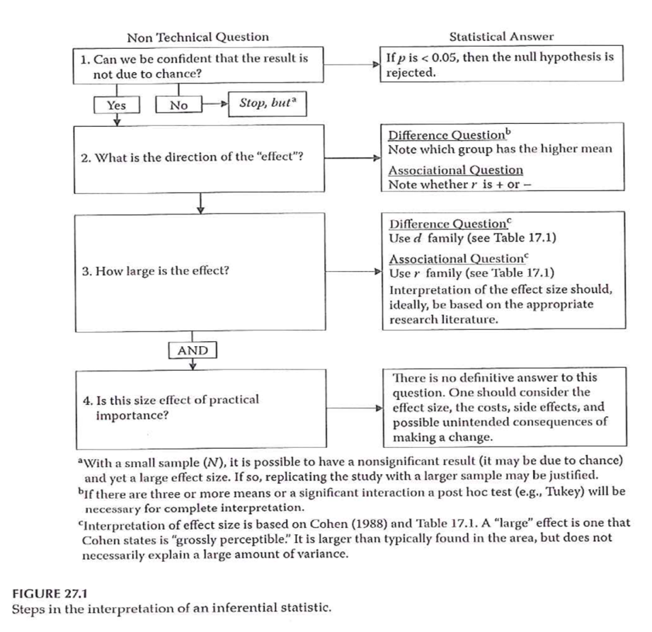
Reporting Clinical Research

Slide 27
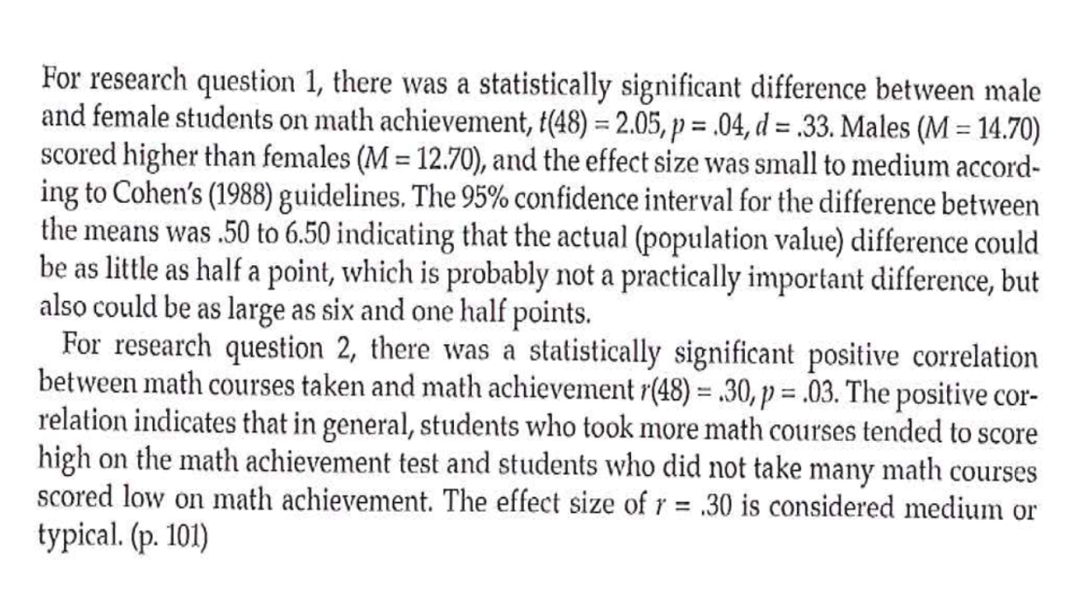
Reporting Clinical Research

Slide 28
Reporting Clinical Research
Poster presentation
Content and layout
Materials

Slide 29
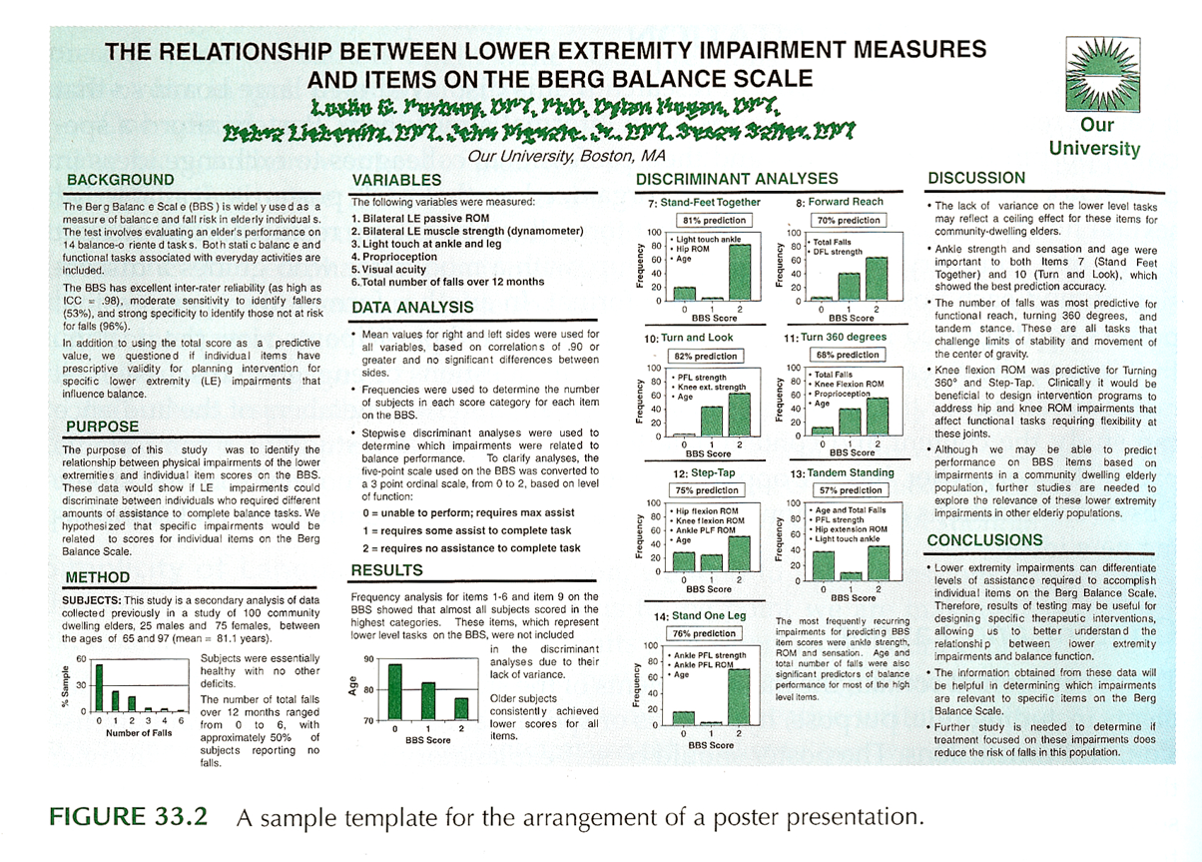
Reporting Clinical Research
Notes:
Portney & Watkins, 2009

Slide 30
Reporting Clinical Research
Oral presentation
Planning and preparation
Visual presentation
Types of slides
Limiting words
Contents of slides
Graphics
Backgrounds and colors
Rehearsal

Slide 31
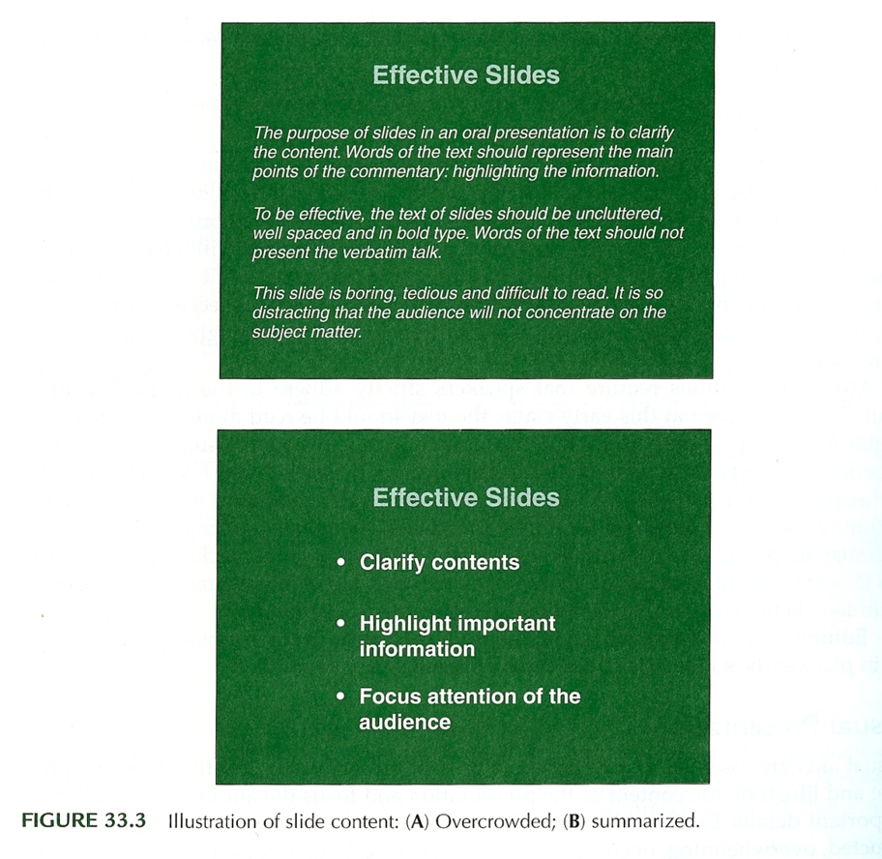
Reporting Clinical Research
Notes:
Portney & Watkins, 2009

Slide 32
Final Projects
Paper (up to 200 pts)
Class Presentation (up to 40 pts)
Poster (up to 10 pts)
Due dates
Presentation & Poster – last day of class
Section 0002 – Thursday, May 3, 2018
Paper – Finals week
Section 0002 – Tuesday , May 10, 2018

Slide 33
Final Projects
Format – Refer to the grading rubric and information in the Syllabus for web sites with relevant information
Presentation –
Research conference style – Presentation then discussion
Time: 10-min presentation
Structure: Objectives, Background, Methods, Planned analyses, Implications
Prepare “slides” for visual support

Slide 34
Final Projects
Poster –
Overlap between poster material and presentation visual material
Submit poster material as a PowerPoint file (.ppt or .pptx)
Due on the day of presentations

Slide 35
Final Projects
Written Research Proposal
Turn in through Turnitin link on the course Blackboard site by 5pm on the due date
Structure – Refer to the grading rubric; truncated version of the five-chapter thesis format
Introduction to the problem (Chapter 1)
Review of the literature (Chapter 2)
Description of methodology (Chapter 3)
Proposed implications of the study
References

Slide 36
Final Projects
Written Research Proposal
Title –
First chance to get reader’s attention
Brief, but descriptive
Abstract –
Next chance to get reader’s attention
Publication - May be the only part of the article read by most
Proposal – needs to present a summary of the proposed study

Slide 37
Final Projects
Written Research Proposal
Introduction – (approx. 1-2 pages)
Introduce the topic / Frame the problem – convince reader that there is a significant issue/concern that needs to be addressed. “Critical need” “So what?”
How your proposed project will address the “critical need”
Aims / goals / objectives of proposed study
Expectations / Impact of findings

Slide 38
Final Projects
Written Research Proposal
Review of the Literature –
Organized to support what you want to do
NOT an annotated bibliography
Represents your understanding of the relevant literature
Provides background to justify your proposed study
Final section -
Gaps in the literature – what needs to be done
How your proposed study will address those gaps
Describe your research hypotheses / questions

Slide 39
Final Projects
Written Research Proposal
Review of the Literature –
What a literature review is NOT –
Annotated bibliography
Must represent your own words and thoughts –
Reminder of what constitutes plagiarism

Slide 40
Final Projects
Written Research Proposal
Methods
Study design –
Description of the overall study design - how you are going to do your study
Sample –
Description of who is being studied
Where did they come from?
Sampling method
Inclusion and exclusion criteria
Power analysis information could be included here

Slide 41
Final Projects
Written Research Proposal
Methods
Measures –
Describe all the measures that will be obtained/used in the study
If using established scales/measures, provide reference and general description of values that will be obtained
If using measures developed for the study, provide more detail
Will there be pilot testing of the measure?
Organize information about measures –
Outcome measures
Independent variables
Other measures

Slide 42
Final Projects
Written Research Proposal
Methods
Procedures –
Description of how the study will be conducted
How participants recruited and enrolled
Consenting process
Random assignment described if appropriate
Timing information
Length of intervention
Timing of measurements
Length of follow-up
Description of groups / interventions
Compensation / payment if appropriate

Slide 43
Final Projects
Written Research Proposal
Methods
Statistical analysis
Data management and quality checks
Descriptive analysis
Analyses to test hypotheses / questions
Description of analyses should clearly relate to each hypothesis / question
Implications of your study
What will be the impact of your study?
What could be the next step after this study?

